Slide 1

Large Scale Data Driven Applications
COS6009-B

Slide 2
The module team
Dr Sohag Kabir (Module Leader)
Office: Horton D4.07
Email: s.kabir2@bradford.ac.uk
Research Interests: artificial intelligence, autonomous systems, safety and reliability analysis, Internet of Things
Weblink: https://www.bradford.ac.uk/staff/skabir2

Slide 3

Module Details
20 Credit Module
How will it be delivered?
1 hr lecture + 1 hr lab + 1 hr tutorial per week
Directed Study: 164 hrs
All learning materials and supporting information on Canvas
Announcements
Discussions
Reading list
Learning materials do not cover everything in depth
Use references, reading list and other resources!

Slide 4
Module Aims
The main aims of this module are to:
Develop a strong understanding of both theoretical frameworks and practical implementation strategies for large-scale data-driven applications.
Explore advanced database design, including features supported by modern Database Management Systems (DBMS).
Build the capability to create scalable, secure, and efficient data-driven solutions that can handle large volumes of data.
Examine issues related to big data, including service-oriented architectures, service organisation, and supporting technologies.

Slide 5
Learning Outcomes
On successful completion of this module, students should be able to...
1
Critically evaluate and synthesise the theories and practices underlying large-scale data-driven applications
2
Design and implement large-scale data-driven applications, applying advanced problem-solving skills
3
Integrate theoretical knowledge with practical skills to analyse, interpret, and address challenging scenarios in data-driven applications

Slide 6

Sources of Large Scale Data
Notes:
UDP: User Datagram Protocol

Slide 7

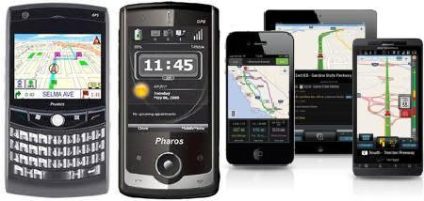





Sources of Large Scale Data
Mobile devices
(tracking all objects all the time)
Social media and networks
(all of us are generating data)
Scientific instruments
(collecting all sorts of data)
Sensor technology and networks
(measuring all kinds of data)
Every minute:
500 hours of video uploaded to YouTube
347k stories posted on Instagram
6 million Google searches
Terabytes of healthcare sensor and satellite data generated
These systems must:
Store petabytes safely
Process them in real time
Make decisions in milliseconds (recommendations, fraud detection, navigation, etc.)
How do we design and scale systems to handle this much data… reliably and intelligently?
Notes:
UDP: User Datagram Protocol

Slide 8
What is this module about?
Discuss fundamentals of Big Data Management
How to design SQL/NoSQL databases, query databases, build applications with them.
How to debug them when they go wrong!
Not how to be a DBA or how to tune the database.
We’ll cover how database management systems work
And some (but not all of) the principles of how to build them
Notes:
UDP: User Datagram Protocol

Slide 9
Why should I learn/study this module?

Slide 10
Why should I learn/study this module?
High Demand for Data Skills: Gain expertise in designing and managing large-scale data systems, highly sought after in today’s data-driven industries.
Industry Relevance: Data-driven applications are transforming industries, and this module provides the knowledge to contribute to cutting-edge advancements.
Career Advancement: Equip yourself with cutting-edge skills to stay competitive in a rapidly evolving job market dominated by data and technology.
Problem-Solving Skills: Learn to design and optimise complex systems to address real-world challenges, developing valuable problem-solving abilities.
Hands-on Experience: Develop practical skills through projects focused on building scalable, secure, and efficient data solutions.

Slide 11
Module Outlines
Study of Open Source NOSQL Database
MongoDB Installation
Basic CRUD operations
Application Development using NoSQL
Introduction to Big Data Concept
Overview on SQL and RDBMS
Difference Between SQL and NoSQL

Slide 12
Module Assessments
Summative Coursework
Design, implementation, and critical analysis of a web-based application offering a range of functionalities for processing and managing a large dataset.
Weighting: 100%
Supplementary Assessment: same as the original assessment

Slide 13
Module Assessments: Examples
Dataset Used in 2024
📂 Healthcare No-Show Appointment Dataset
Size: 107,000 records, 15 attributes
Context: Tracks whether patients attended or missed scheduled medical appointments in 2016
Key Features:
Demographics: Age, gender, neighbourhood
Medical Conditions: Hypertension, diabetes, alcoholism, handicap
Appointment Details: Date scheduled, appointment date, SMS reminders
Target Variable: No-show status (Yes/No)
Potential Analyses:
Predicting no-show likelihood
Identifying factors influencing missed appointments
Visualising attendance trends over time or by demographics
✅ Analysed the dataset to uncover insights
✅ Developed both SQL and MongoDB versions of the databases
✅ Using MongoDB version of the database to achieve real-time dashboard with multi-level filtering
✅ Strong visualisation (interactive graphs, performance metrics)
✅ Clear documentation and architecture diagrams

Slide 14
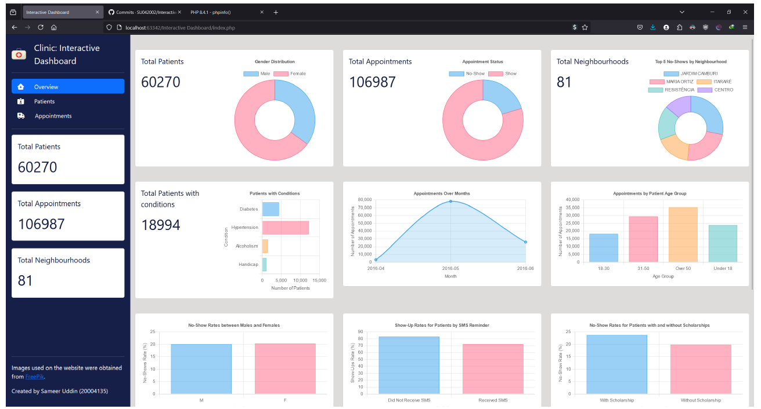
Module Assessments: Examples

Slide 15
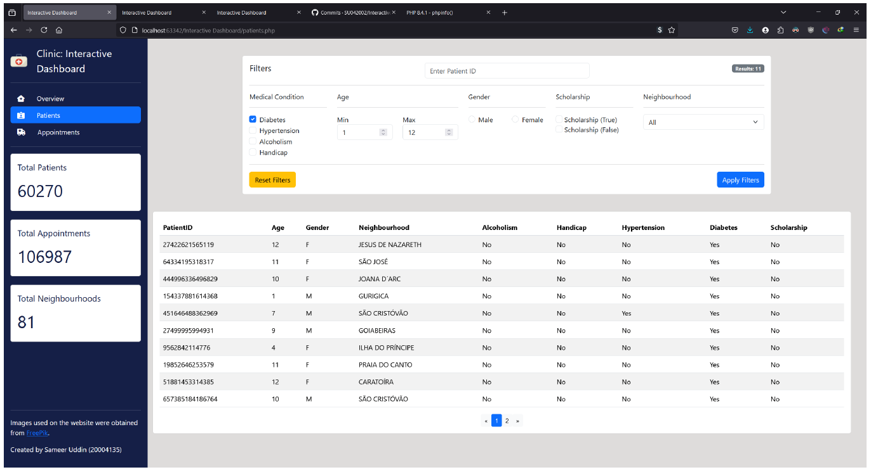
Module Assessments: Examples

Slide 16
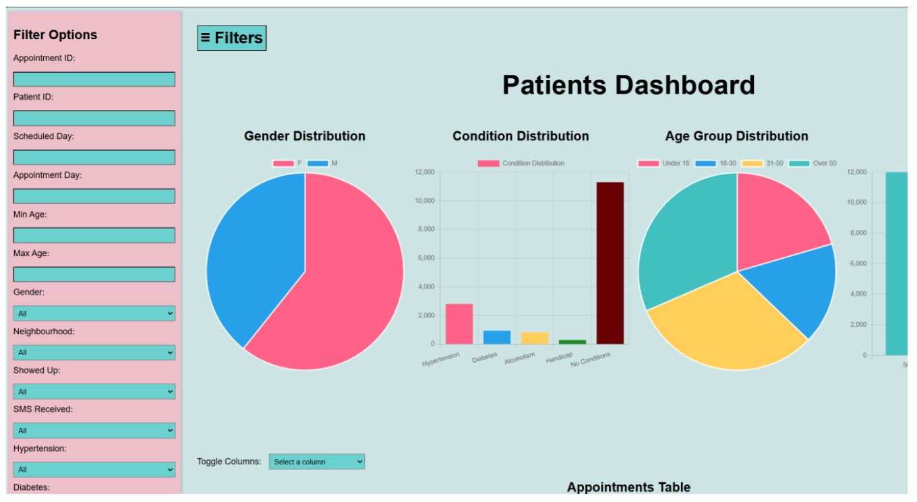
Module Assessments: Examples

Slide 17
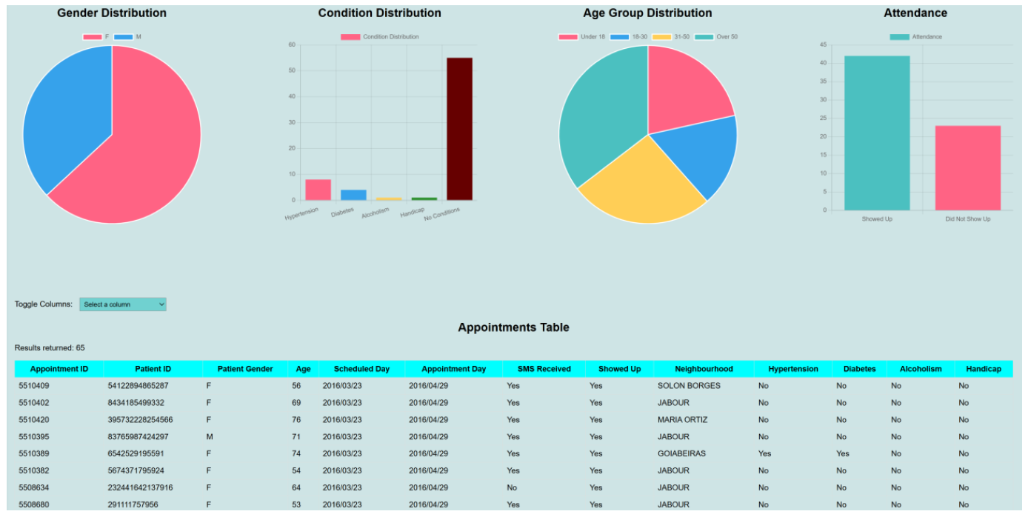
Module Assessments: Examples

Slide 18
CW Extension and Extenuating Circumstances
Various factors can negatively impact your performance
Health issues, family issues, etc.
Support is available to help you navigate challenging situations
For legitimate reasons, you can request an extension or apply for ECs
Need to provide evidence to support your request
Do I have the authority to grant extension or EC requests?
CW Extension and Extenuating Circumstances Processes
Follow the guidelines provided on the processes for EC and coursework extension
Please refer to the Extensions and Extenuating Circumstances page for detailed guidelines
Personal Tutors can also contribute to your CW extension and EC applications (if it is genuine).

Slide 19
Reading List
Database systems: a practical approach to design, implementation, and management by Connolly, Thomas M; Begg, Carolyn E
MongoDB 4 Quick Start Guide : Learn the Skills You Need to Work with the World's Most Popular NoSQL Database by Bierer, Doug
MongoDB Recipes: With Data Modeling and Query Building Strategies by Chellappan, Subhashini; Ganesan, Dharanitharan
Learning PHP, MySQL, and JavaScript: a step-by-step guide to creating dynamic websites by Nixon, Robin

Slide 20
How to Succeed
Attendance to lectures and labs is linked to performance/grades
Please ask questions!
In the labs, ask for help
Independent (directed) study is required
Attending lectures is not enough!
Learning materials on Canvas is not exhaustive (use references, reading list and other resources)
Put into practice what you learn

Slide 21
Questions?

